Slide 1
When I was Young
These slides show some of my precious memories.
Sometimes life is hard.
I hope these slides can support me in some way.
They will reminder us that life have many interesting aspects and we do not need to always focus on work.
They will reminder us that something can be done, even though we never believed it can be done before it’s done. They will reminder us, we have friends or/and family around us.
I’m collecting more photos. Even though I did not have a good habit to organize them, and lost many many precious memories.

Slide 2
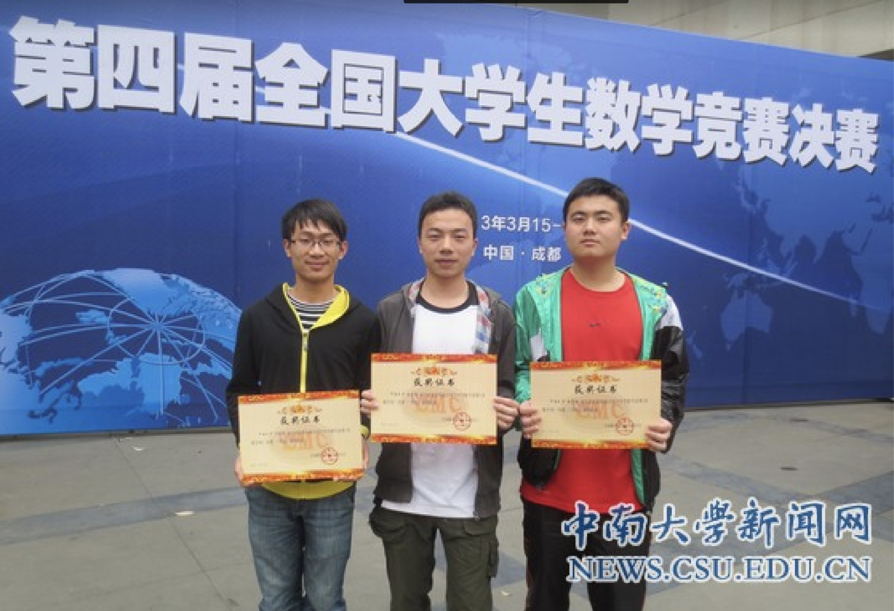
I really appreciate this experience.
I won first prize in this competition (rank 17 in china, rank 1 in Hunan province). Two friends (in the picture) also achieved great results.
After this competition, professors asked me if I’m interested in research. Before that, I never know what research is, and never think about being a researcher.
Up to now, I still think it is the hardest prize that I ever achieve.
2013, when I was in my second year of undergraduate.

Slide 3
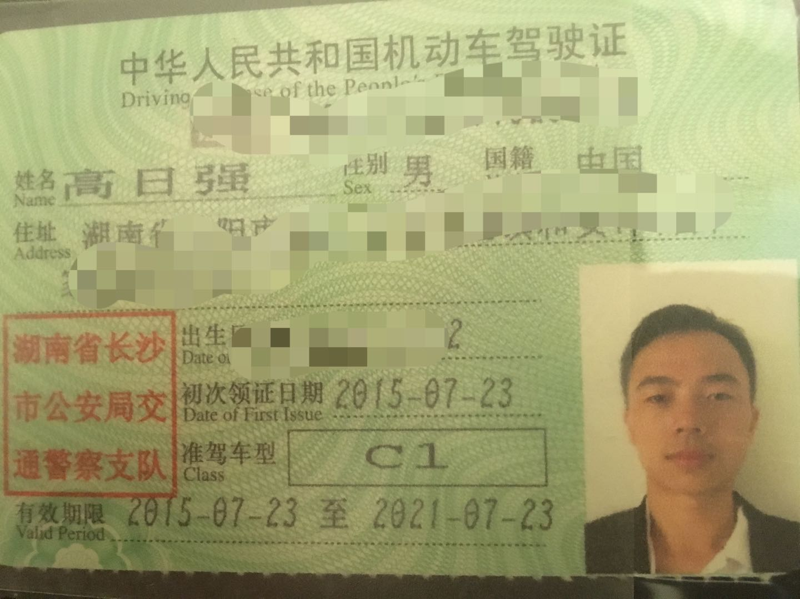

I really miss the time when I was young.
Even a photo on driver license at that time is better than a photo after PS now.

Slide 4
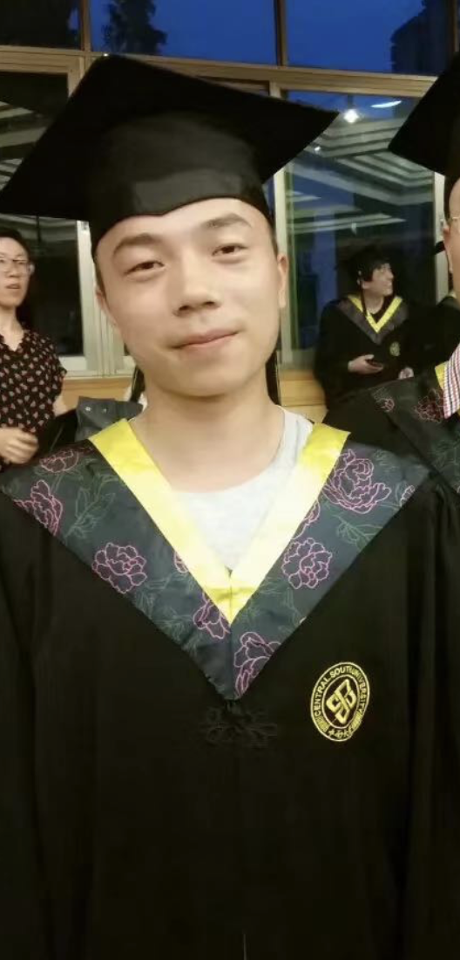
Well, currently, I only find this picture (with this stupid expression) during my bachelor graduation ceremony. I will ask friends to send me more.
I lost lots of photos by storing online !!!
I remember we do have much better photos !!!!

Slide 5
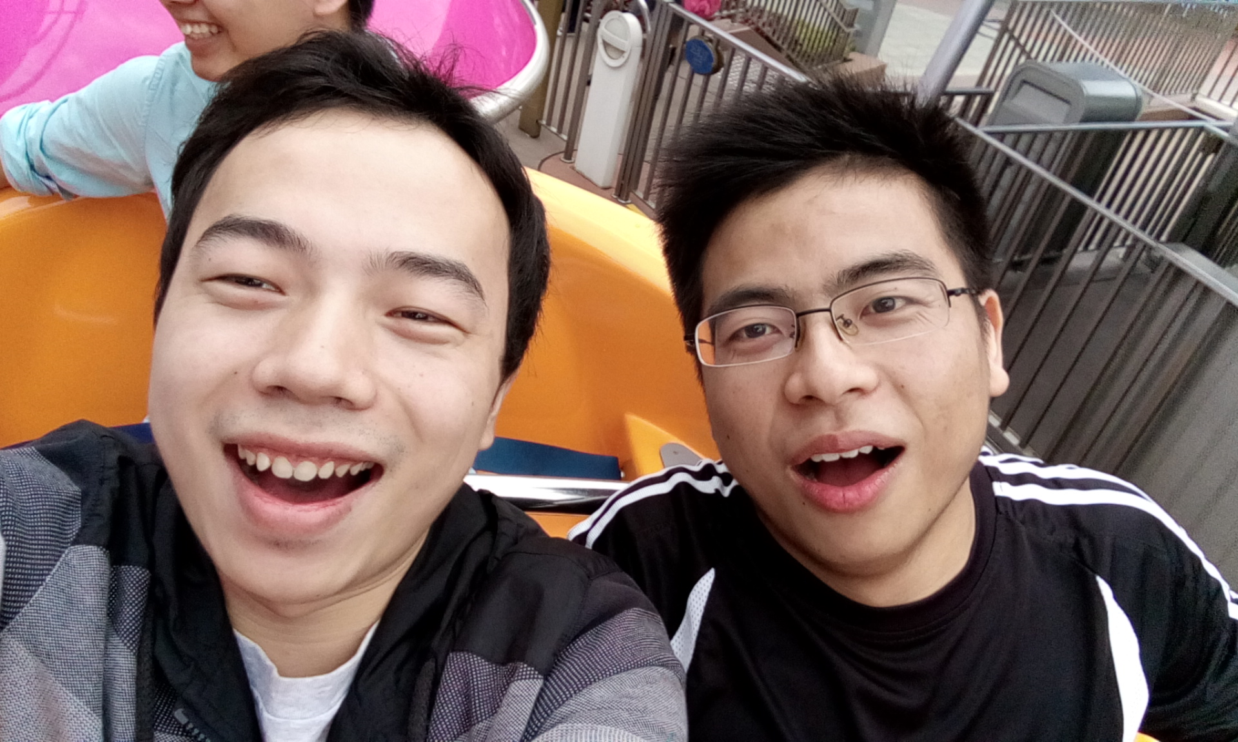
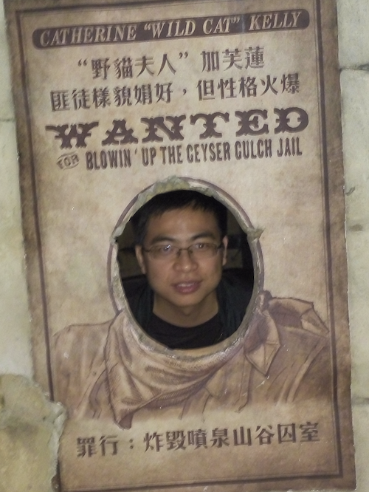
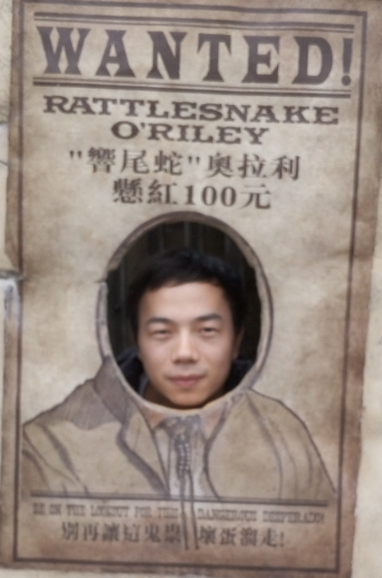
We were playing in Disney.
I appreciate this guy, who lead me to pursuing a Ph.D. degree.
~2017?? I guess

Slide 6
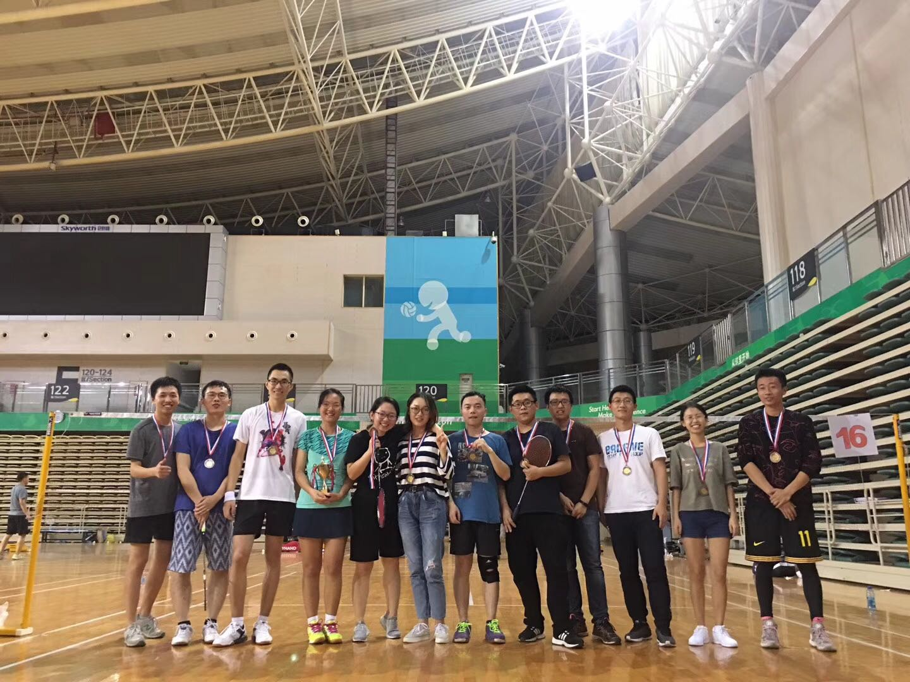
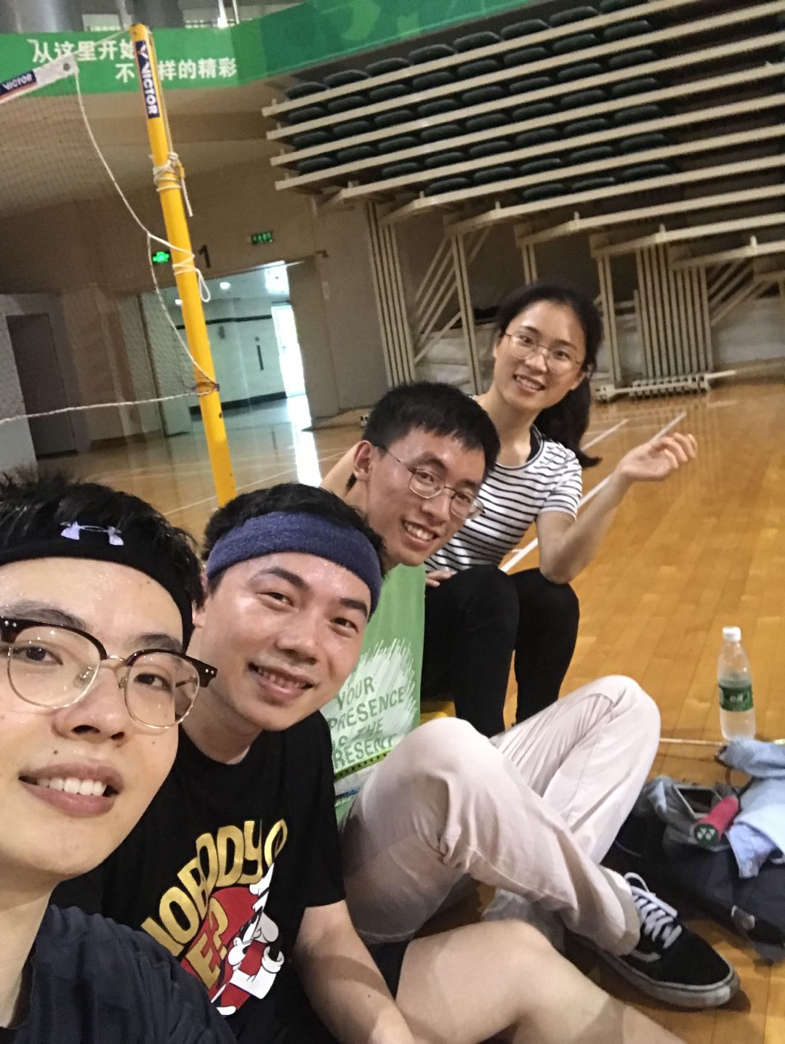
Badminton time. I did not lie, we did win something ☺.

Slide 7
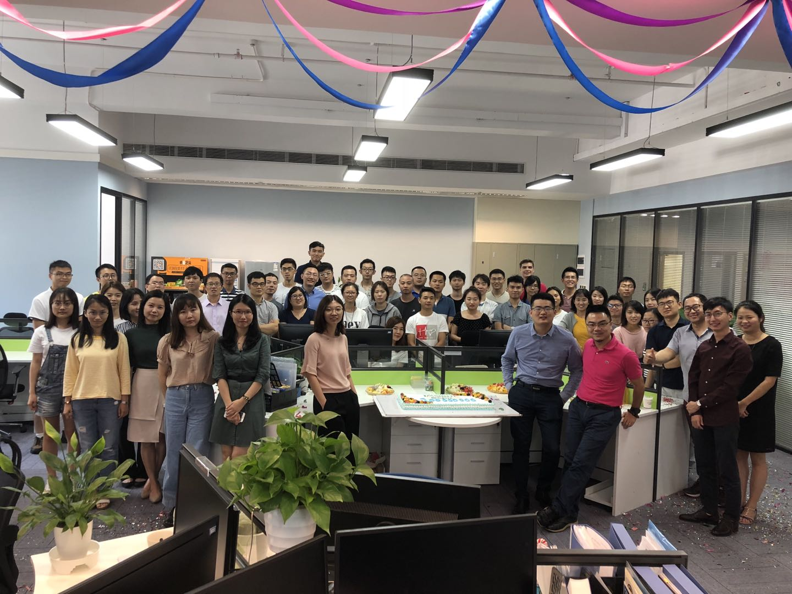
Internship in Imsight Technology.
Including supermen in medical imaging (please find them).

Slide 8
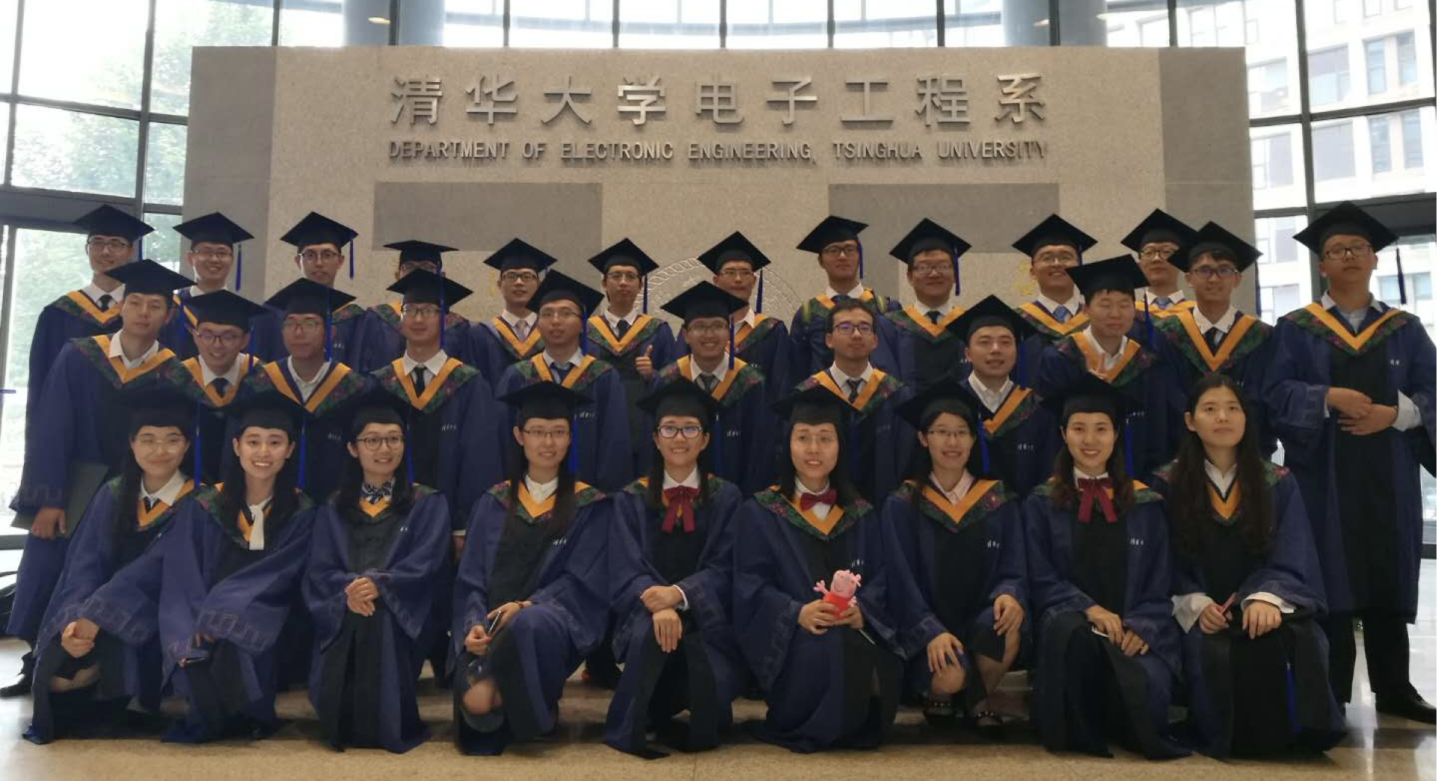
Our class in Tsinghua. Anyone can find me can ask me for an award.

Slide 9
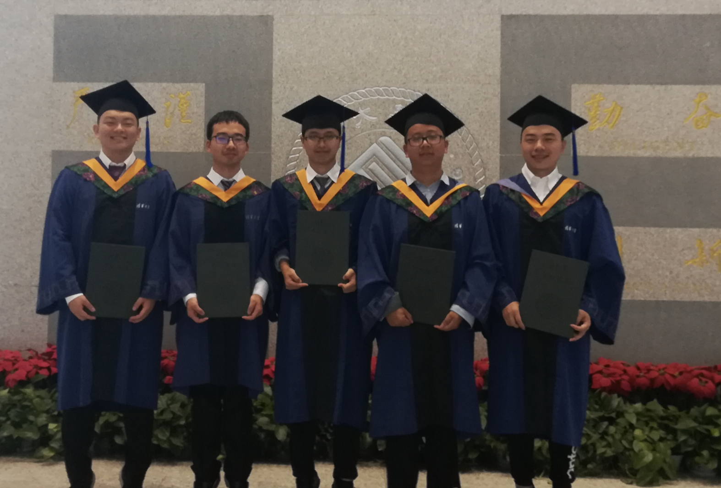
Some of my labmates. You may not notice that, everyone is on tiptoe to look taller.

Slide 10
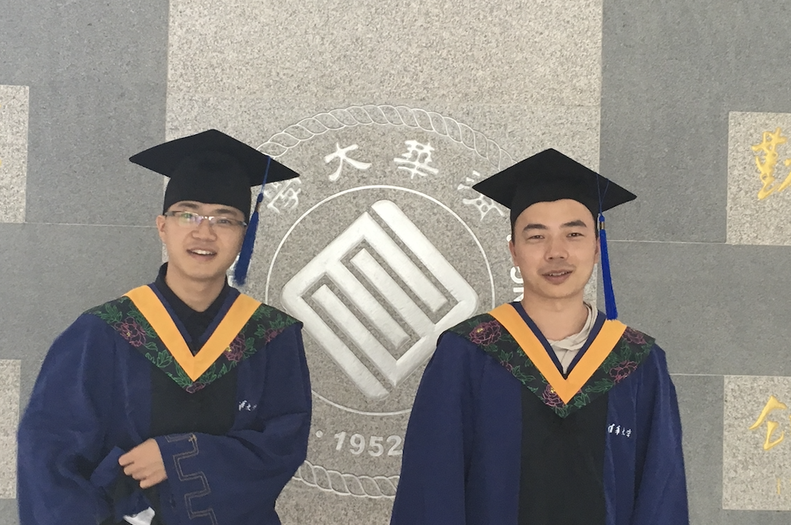
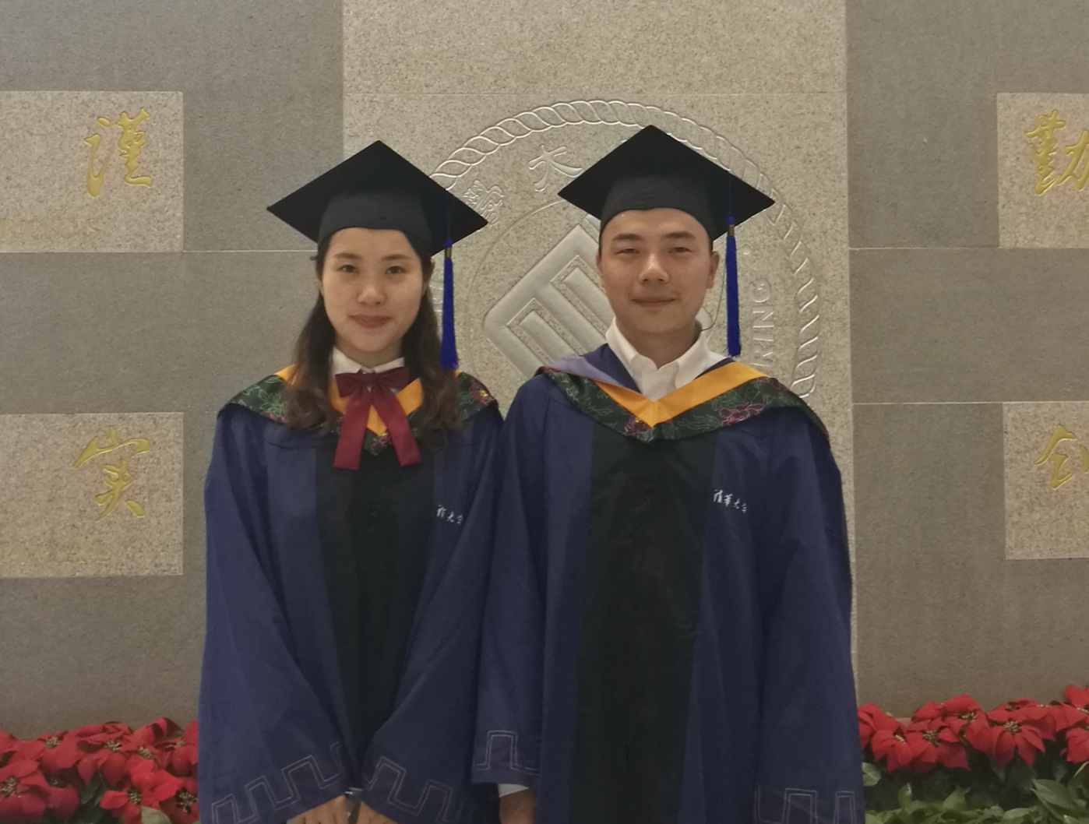
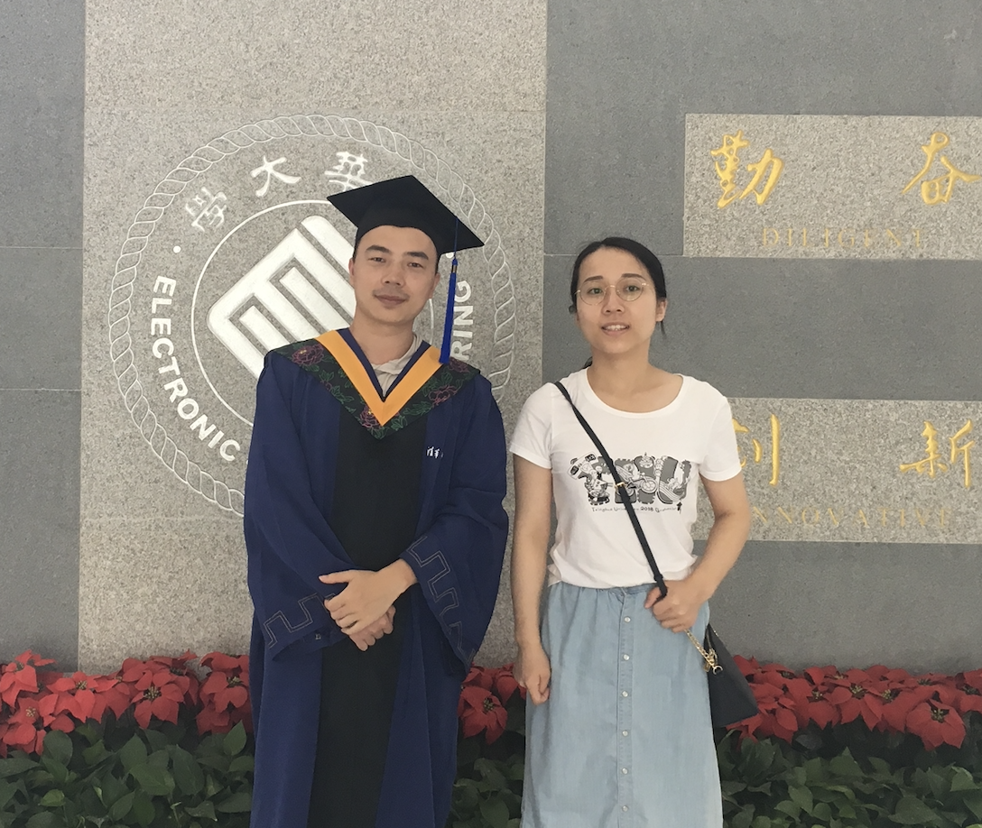
One pity is I did not dress well to for photos and ceremony. I should spend more time and money on dressing.
Good friends that I can find paired photos. We usually chat in a group even have graduated for several years.

Slide 11
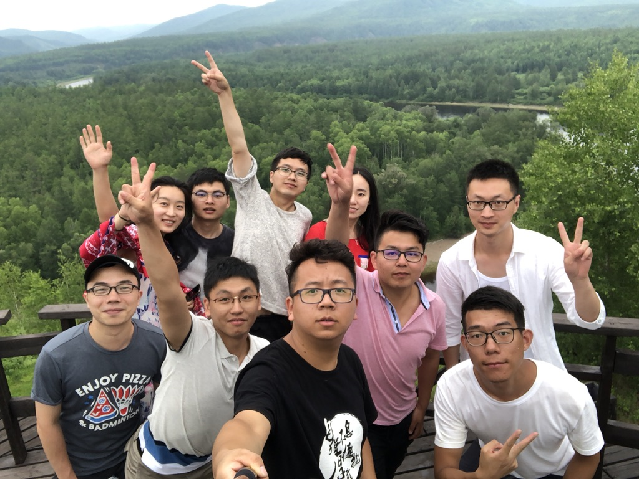
Graduation Travel to the north of China.
Had a great time!!
2018

Slide 12
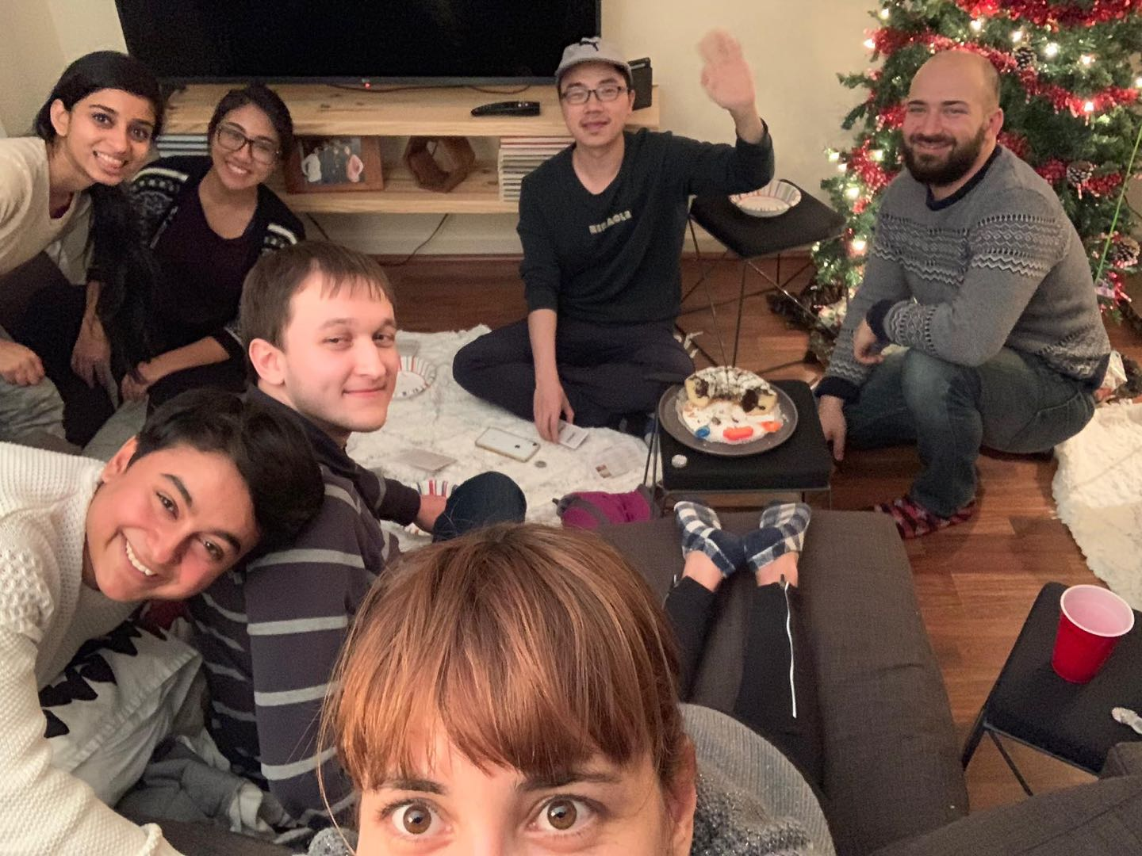
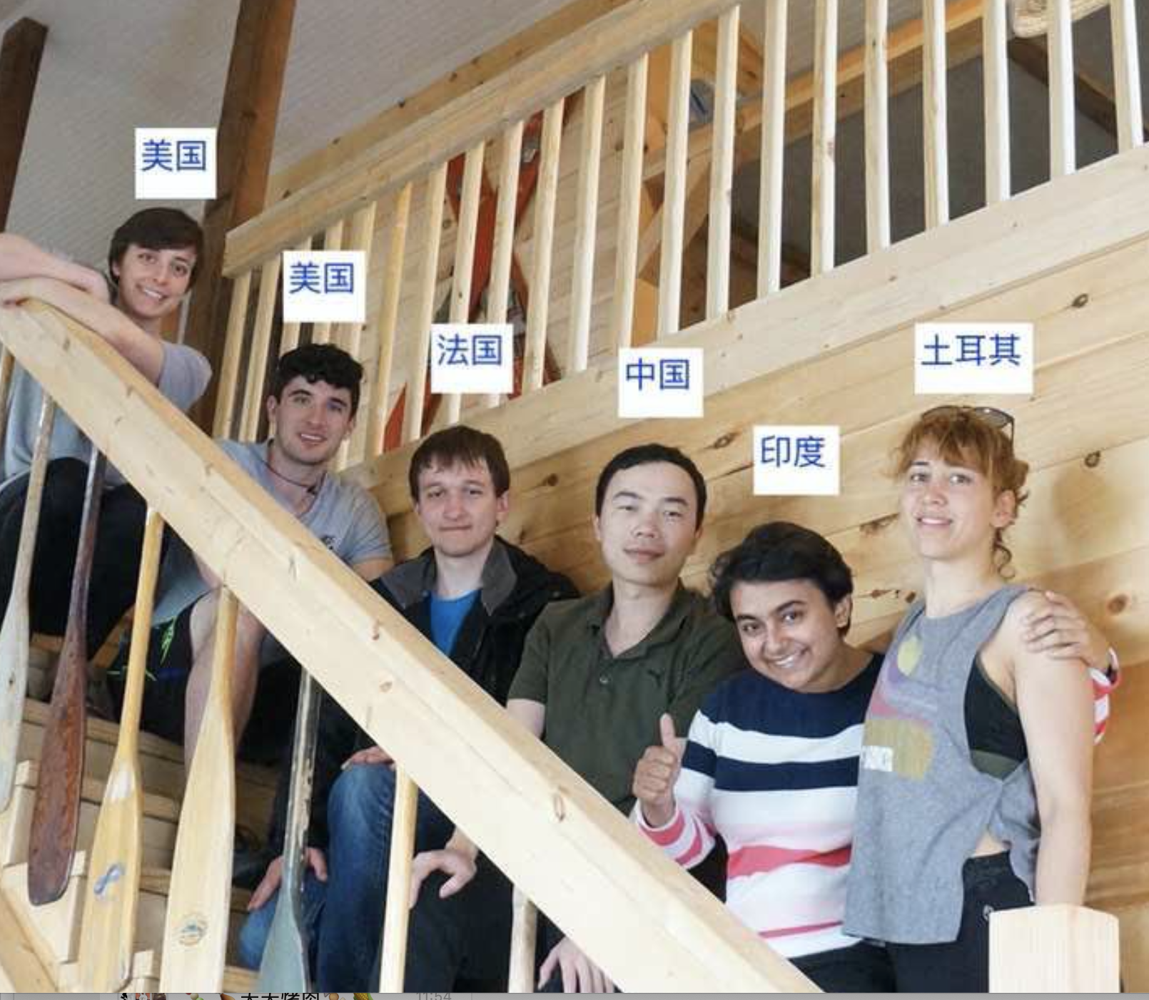
← A Christmas party in Roza’s house. Thanks to Roza’s invitation and organizations, I got multiple chance to closely experience different cultures. 2019
A traveling to Kentucky, 2019 →

Slide 13
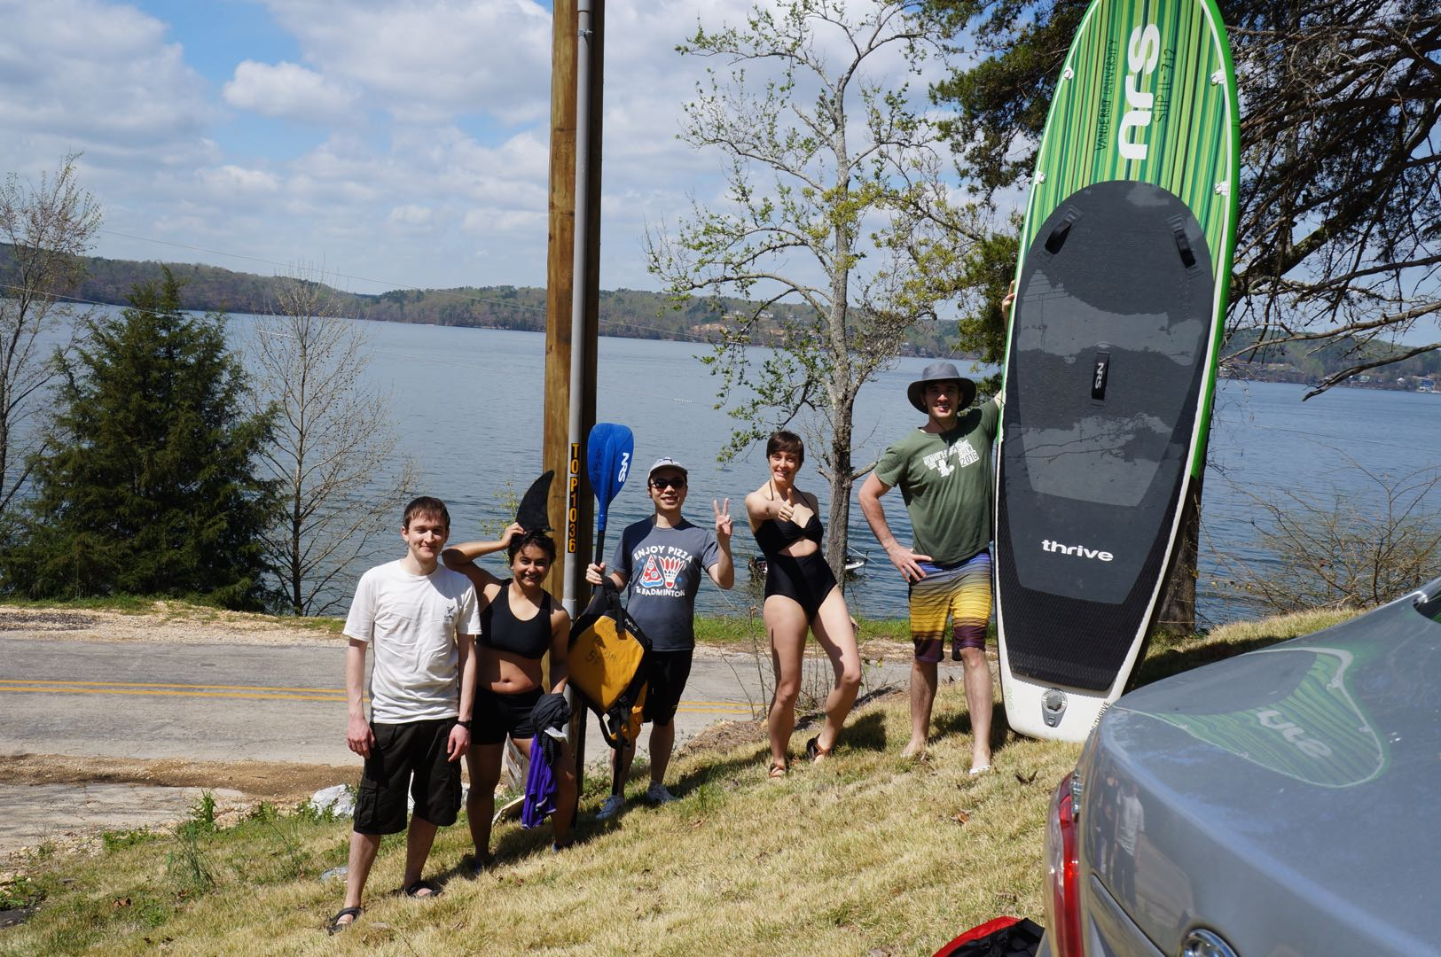

Slide 14
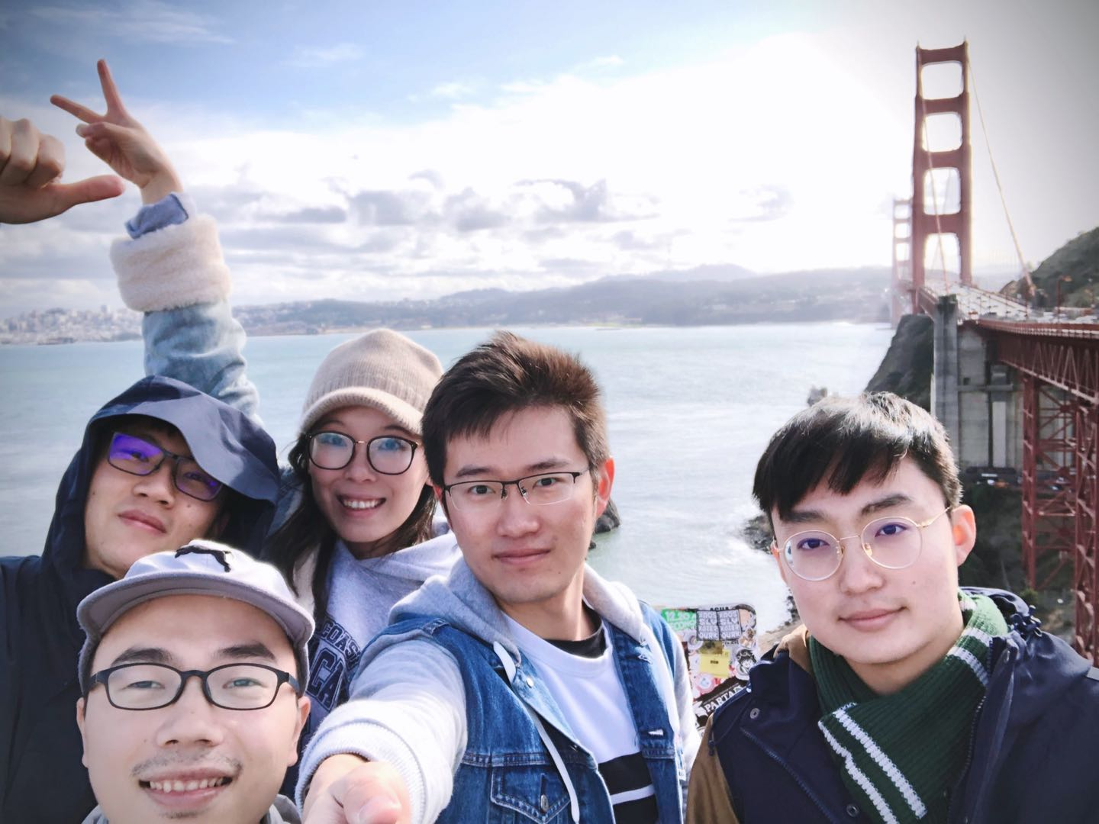
Traveling to West USA with friends.
2019

Slide 15
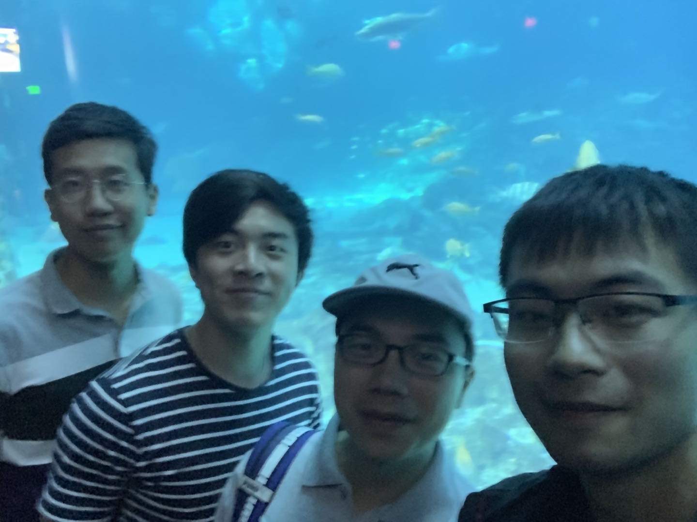
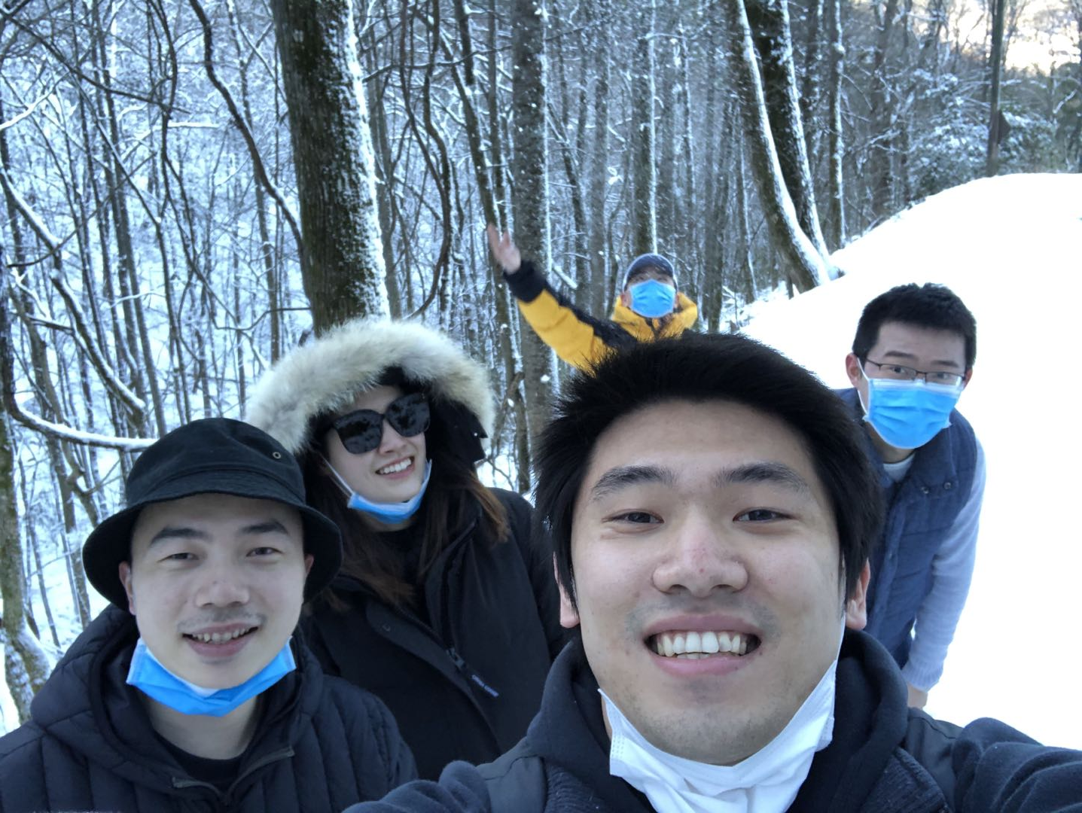
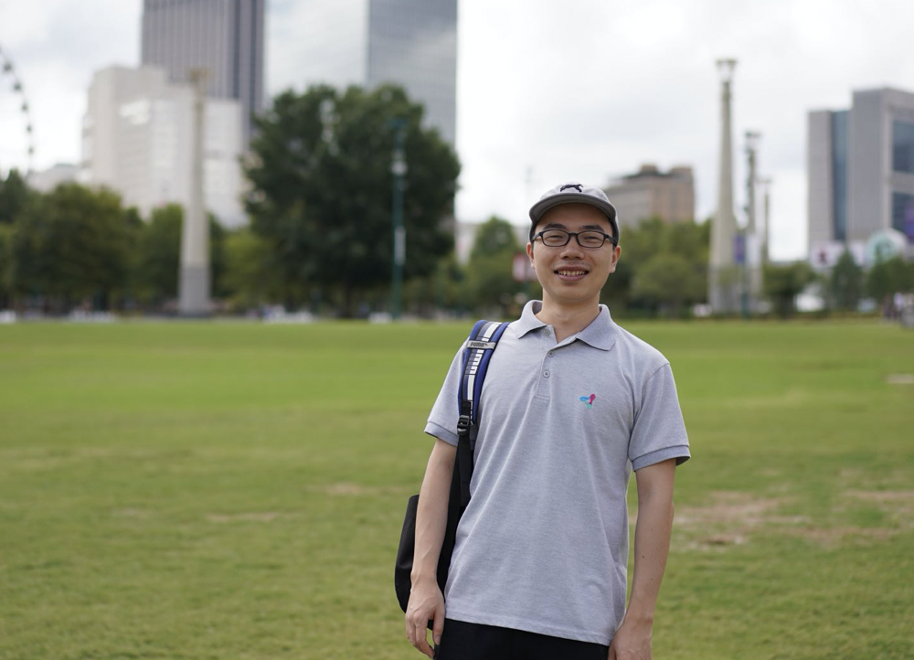
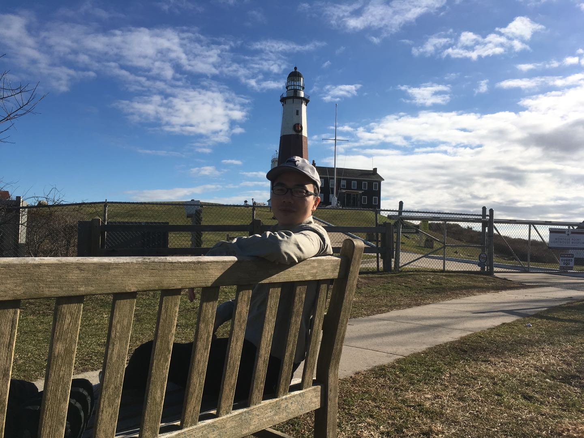
Atlanta
Smoky Mountain
New York

Slide 16
To be continued …………..
Unfortunately, a lot of activities can not in my mind now because I cannot find a photo for them.

